Slide 1


Profit & Loss

Slide 2



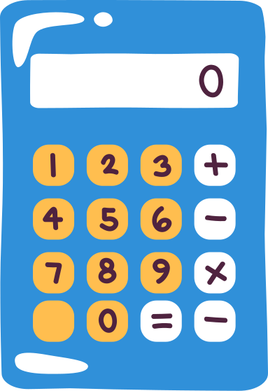

Selling Price(SP)
Cost Price(CP)
The price at which an article is sold.
The price at which an article is manufactured.
CONCEPTS
Marked Price(MP)
The price at which an article is marked or labelled.

Slide 3
Loss (L)
Profit (P)
Selling price < Cost price
CONCEPTS
Selling price > Cost price
Discount (D)
Selling price < Marked price

Slide 4

KEY FORMULAS
Profit = S.P. - C.P.
Loss = C.P. - S.P.
Profit % = (Profit / C.P.) × 100
Loss % = (Loss / C.P.) × 100
S.P. = [(100 + Profit %) / 100] × C.P.
C.P. = [100 / (100 + Profit %)] × S.P.
Discount = M.P. –S. P.
Discount % = (Discount/M.P) × 100

Slide 5

1)Manish bought a car for Rs.1,50000 and sold it for Rs.2,10000. Find the profit percentage made by him on selling the car?
A.38%
B.35%
C.40%
D.42%

Slide 6

2) Alfred buys an old scooter for Rs. 4700 and spends Rs. 800 on its repairs. If he sells the scooter for Rs. 5800, his gain percent is:
A.4(4/11)%
B.5(5/11)%
C.10%
D.12%

Slide 7

3) The selling price of 40 items is equal to the cost price of 45 items. What is the net profit or loss%?
A.10% loss
B.12.5% profit
C.15% loss
D.17.5% profit
PROFIT or LOSS?

Slide 8
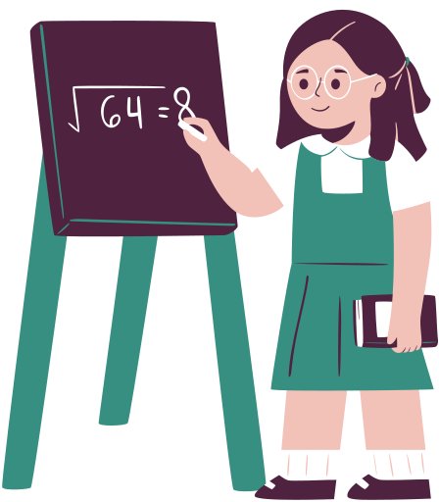
4)A trader bought a certain number of calculators at a rate of 30 for Rs.15000 and sold them at 40 for Rs.16000.What is the profit or loss percentage?
A.30% Profit
B.25% loss
C.20% profit
D.20% loss

Slide 9

5)The profit earned after selling an article for Rs.900 is thrice the loss incurred after selling the article for Rs.300.What is the cost price?
A.450
B.500
C.600
D. 350

Slide 10

6)A trader sold a TV for Rs.27500 and gained 10%.Find the cost price of the TV?
A.25000
B.22500
C.24750
D.22750

Slide 11

7)By selling an article for Rs.360 a man lost 10%.To gain 15% at what price it should be sold?
A.450
B.400
C.460
D. 420

Slide 12
8)A man bought two cows at Rs.780 each. He sold one at a profit of 10% and the other at 10% loss. Find his overall profit or loss percent?
A.1% loss
B.5% loss
C.0% loss
D.1% profit

Slide 13
9)Akhil bought two bags of wheat for 850 each.He sold one bag at a profit of 16% and the other at a loss of 12%.What is the net profit/loss % made by him?
A.2% profit
B.4% profit
C.2% loss
D.4% loss

Slide 14
10)Anil marked an article at Rs.25000.He offered a discount of 28% on the marked price, but still earned a profit of 20%.What is the cost price?
A.18000
B.17600
C.15000
D.16500

Slide 15
11)Pranav sold his shoes after allowing a discount of 20%. If he had sold them after allowing another discount of the same amount, his selling price would have been ₹540. Find the marked price of the shoes.
A.800
B.600
C.900
D.700

Slide 16
12) Shantanu and Keerthana started a business with capitals of ₹45,000 and ₹60,000 respectively and earned ₹56,000 as the profit at the end of the year. What is Keerthana’s share in the profit?
A.32000
B.34000
C.30000
D.40000

Slide 17
13) X and Y started a business with their investments in the ratio of 3: 7. Another person, Z,joins the business six months later with an investment thrice that of X’s. If the annual profit is ₹58,000, find Z’s share.
A.12000
B.18000
C.16000
D.15000

Slide 18

Thank you!

Slide 19

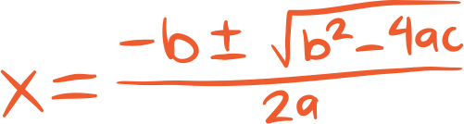



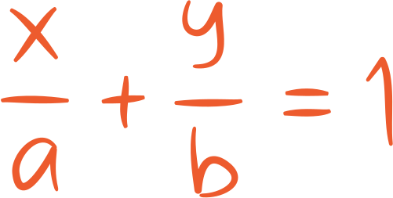
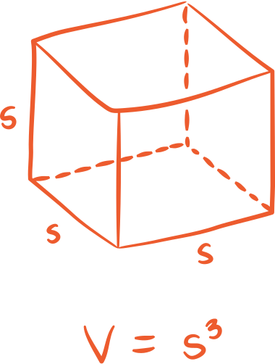
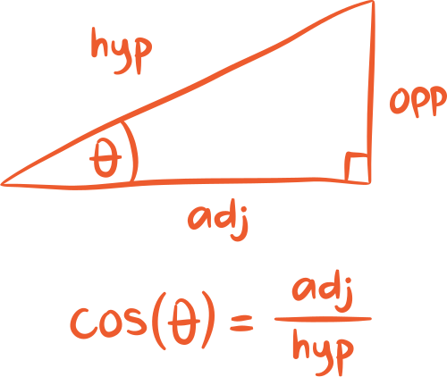
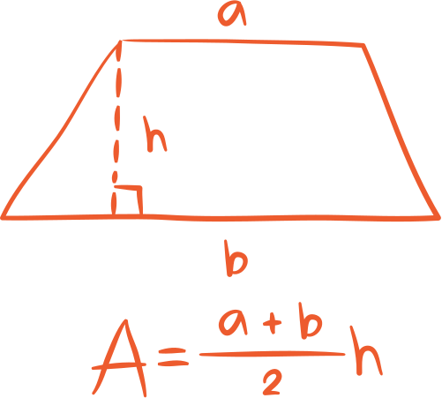
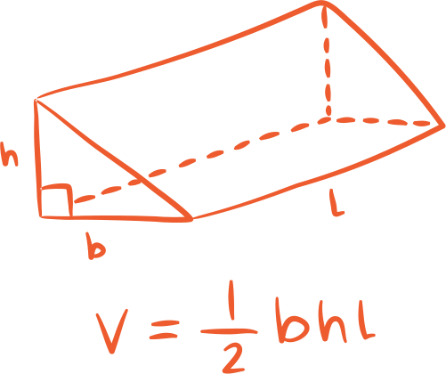
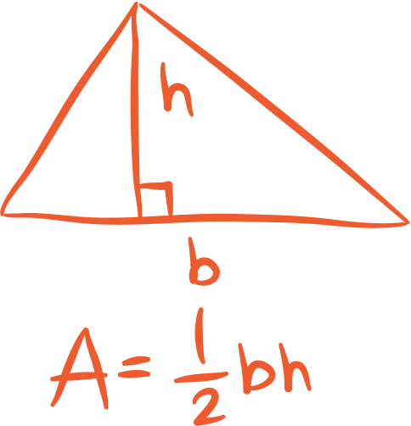
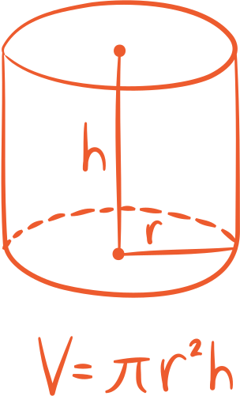
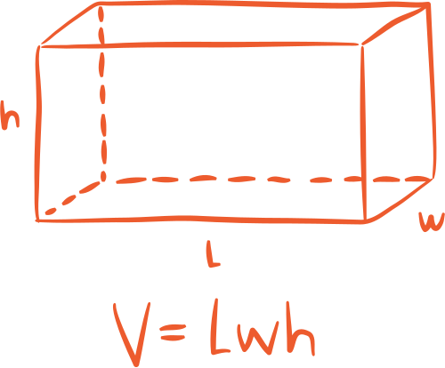
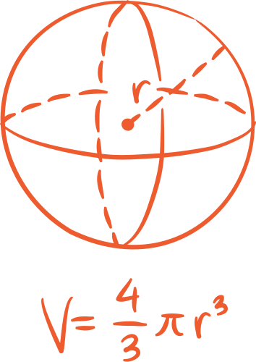
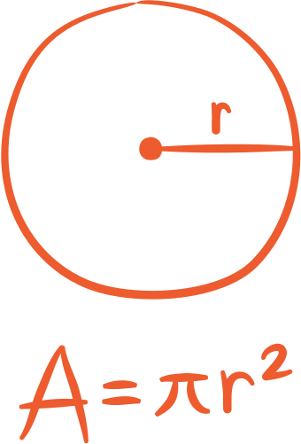
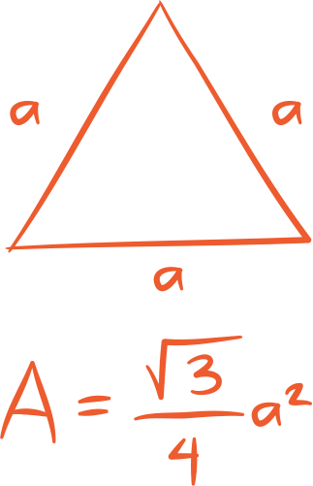
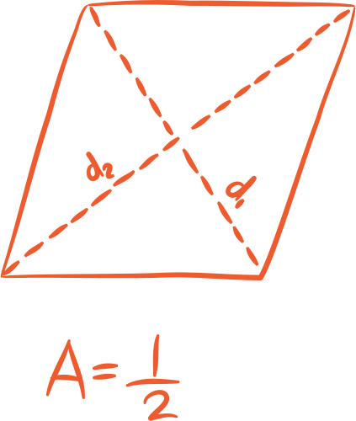
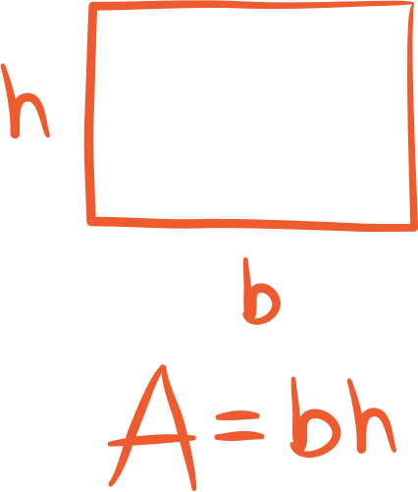


















Resource
Page
Use these design resources in your Canva Presentation.
Use these design resources in your Canva Presentation.
Titles: Caveat Brush
Headers: Roboto
Body Copy: Roboto
You can find these fonts online too. Happy designing!

